Slide 1
Predicting Stellar Objects

Slide 2
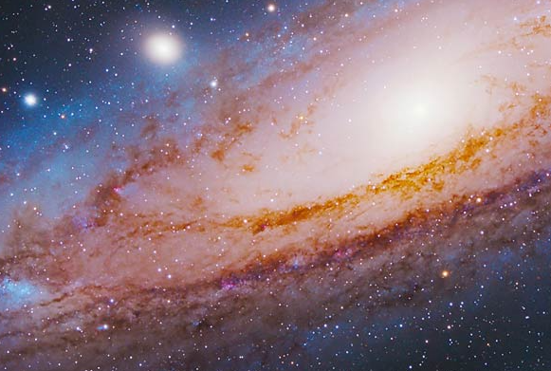
Research Overview
This research Focuses on the use of machine learning models to classify stellar objects into categories. Using a comprehensive large astronomical dataset, the study applies multiple machine learning algorithms to analyze key features including spectral data, photometric measurements, and celestial coordinates

Slide 3
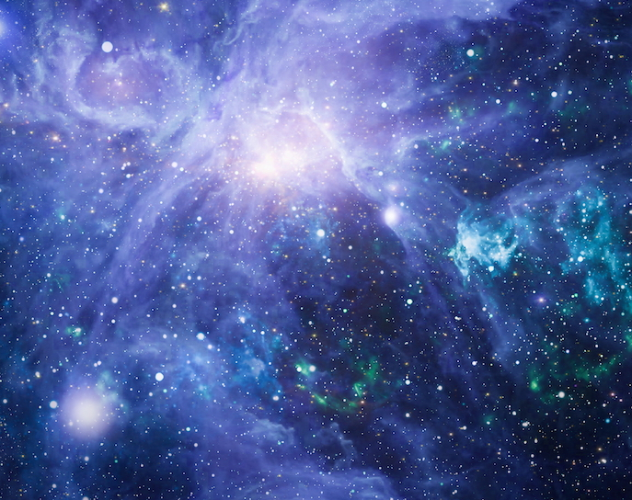
Objective
The objective of this project is to develop machine learning models that can accurately classify stellar objects into stars, galaxies, and quasars. Build a scalable solution that can enhance astronomical cataloging, research efficiency, and our understanding of the universe.

Slide 4
Agenda
Introduction
History and Background
Dataset Overview
Data Preprocessing
Exploratory Data Analysis
Multicollinearity check
Feature Selection and Feature Engineering
Model Building
Conclusion
Deployment

Slide 5
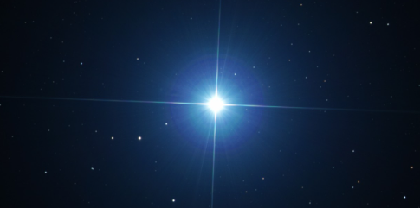
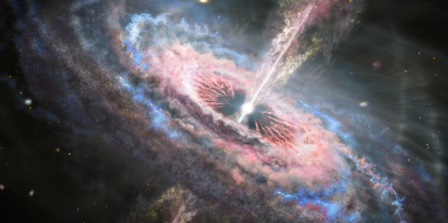
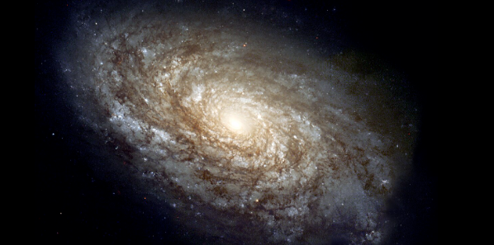
Stellar Object Classification
Context
The universe contains billions of celestial object such as stars, galaxies, and quasars.
Astronomers use large scale surveys to collect massive dataset
Problem statement
Manual classification of these objects are time-consuming and prone to errors
Traditional methods struggles with large volume of data
Role of Machine Learning
Machine learning can help automate classification, handle big datasets, and improve accuracy
Machine will help in astronomical cataloging and expanding our understanding of the universe.

Slide 6
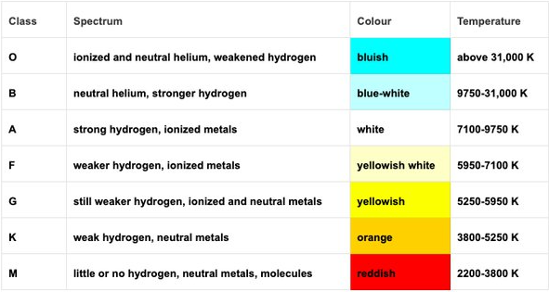
History & Background
Harvard System (OBAFGKM types)
Early Classification (Pre-20th Century)
Astronomers relied on manual observation and brightness / colour to classify stars.
Spectral Classification (20th Century)
Introduction of spectroscopy allowed classification based on light spectra.
Harvard Classification (OBAFGKM types) became standard.
Digital Sky Surveys (Late 20th – 21st Century)
Large-scale surveys (e.g., Sloan Digital Sky Survey – SDSS) produced massive datasets with millions of objects.
Modern Challenge
Manual methods can’t keep up with the scale and complexity of astronomical data.
The Harvard spectral classification system, with its OBAFGKM sequence representing different stellar temperatures, became the standard for classifying stars after being refined by Annie Jump Cannon and published in the 1920s.

Slide 7
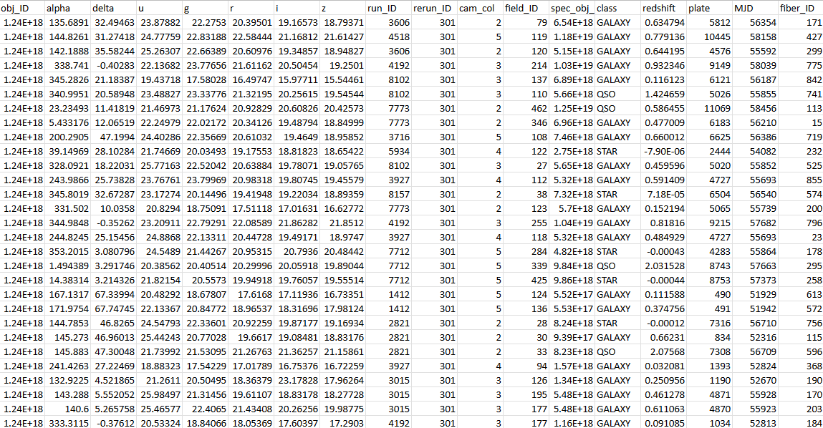
Dataset Overview
Source: Sloan Digital Sky Survey (SDSS) dataset was extracted from Boston institute of Analytics.
Key Attributes:
obj_ID → Unique identifier for each object
alpha (RA) → Right Ascension (celestial longitude)
delta (Dec) → Declination (celestial latitude)
u, g, r, i, z → Magnitude values in 5 photometric filters (ultraviolet to near-infrared)
run_ID, rerun_ID, cam_col, field_ID → Imaging metadata
spec_obj_ID → Unique identifier for spectroscopic observation
class → Object category (Star, Galaxy, Quasar)
redshift → Measure of how much light is shifted due to universe expansion (important for galaxies/quasars)
plate, MJD, fiber_ID → Spectroscopic plate, observation date, and fiber ID
Size: ~( 100k objects × 18 features)
Target Variable: class (Star / Galaxy / Quasar)

Slide 8
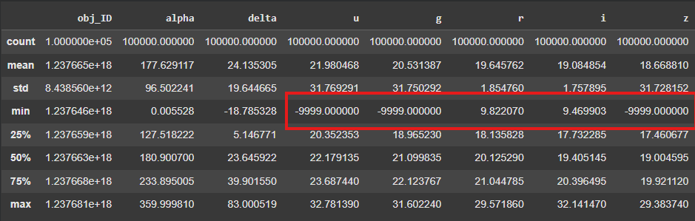
Data Preprocessing
The categorical variable "class" was converted into numerical form using Label Encoder.
Photometric data contains corrupted or missing data cells that has been replaced by extreme negatives (-9999) as placeholder. To handle this we need to convert them into null values and drop the observation.
The dataset was checked for null values and was observed to have no missing values.
Only Corrupted observation has been dropped.
We will be scaling our data later after Feature selection on the final Model datasets

Slide 9
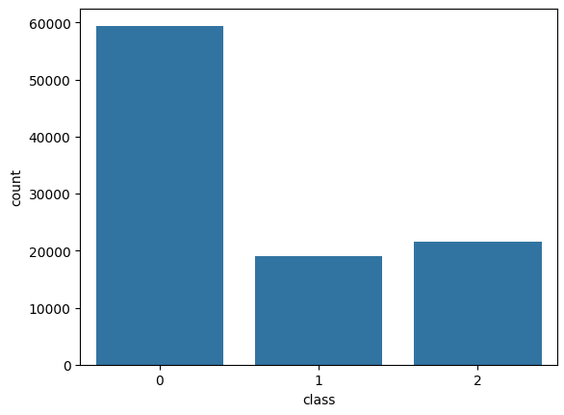
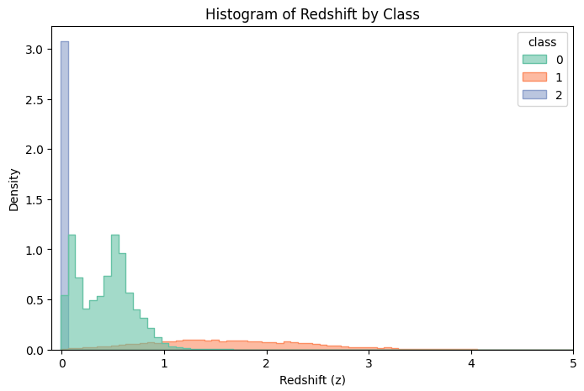
Data Visualization
Class Countplot
Class distribution by Redshift
Density Distribution Plots

Slide 10
Class Countplot :
The Galaxy class makes up around 59% of the dataset → more than half.
The Quasar class is much smaller, about 18%.
The Star class is around 21% → also smaller but not extremely rare.
So, the model may tend to favor the majority class (Galaxy)
Class density by Redshift
Appears as stripes at discrete values (redshift = 0 for stars).
Stars cluster at exactly 0.
Quasars and galaxies spread out but are much fewer, so the density is low.
Quasars are more spreadout indicating higher Redshift
Galaxy are spreadout but redshift stays between 0-1
As an object emitting light moves towards an observer, the light reaching the observer will shift towards the blue end of the spectrum, decreasing the wavelength of the light and increasing its frequency. This is called blueshift. If an object emitting light recedes away from an observer, the light reaching the observer will shift towards the red, increasing the wavelength and decreasing the frequency. This is called redshift.

Slide 11
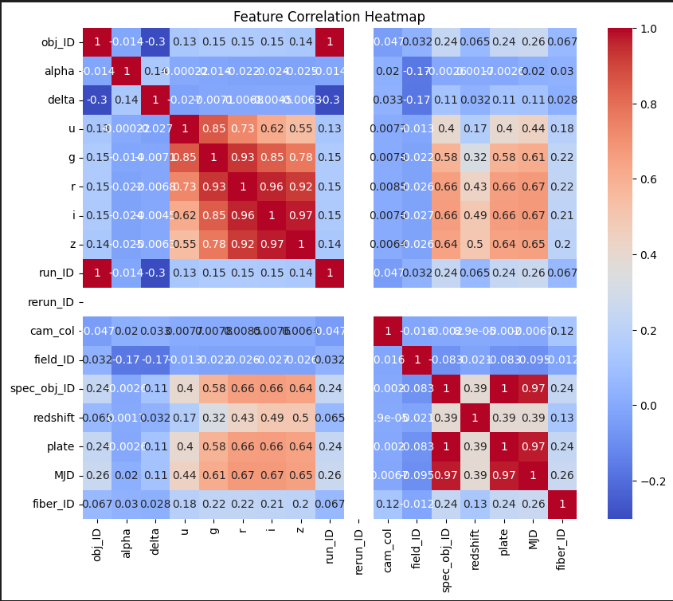
Feature correlation heatmap
Photometric data (u,g,r,i,z)
r vs i= 0.97
i vs z = 0.97
g vs r = 0.93
u is moderately correlated with others (0.55-0.78).
*This shows that filters captures overlapping information*
Identifiers (obj_ID, run_ID etc.)
Almost no meaningful correlation with physical features (mostly <0.15).
*These are IDs only, not physical properties*
Coordinates (alpha , delta)
Low correlation with everything else (<0.15).
*These just specify position in the sky, not photometric/spectral properties. Not really useful for class seperation.*

Slide 12
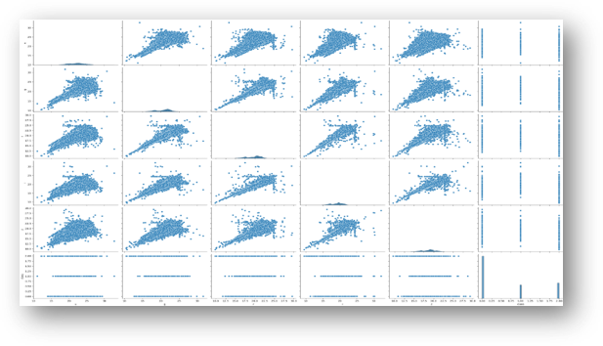
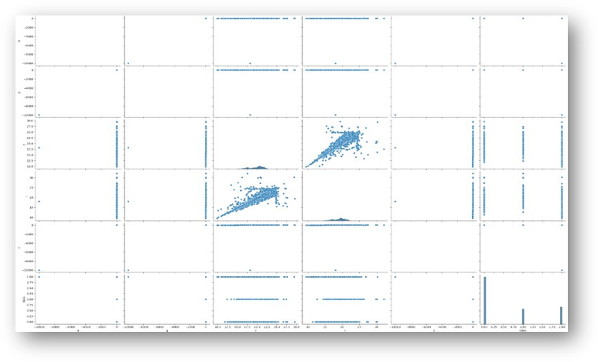
Photometric Pair plot
After Dropping Outliers
Before Dropping Outliers

Slide 13
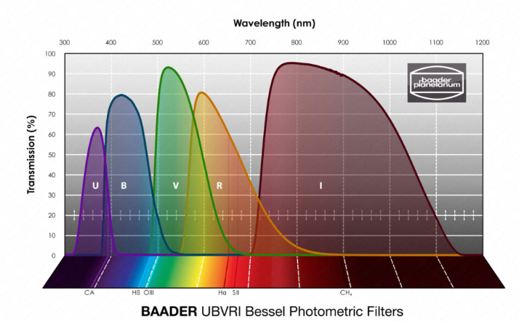
Why This pair plot Matters
Multicollinearity can confuse linear models (like Logistic Regression) because the model can’t tell which variable carries unique information.
Tree-based models (Random Forest, XGBoost) handle collinearity better, but still may overweight redundant features.
The u, g, r, i, z photometric bands are a set of five optical filters (ultraviolet, green, red, near-infrared, and far-infrared) used in astronomy to measure the brightness of celestial objects at different wavelengths
*This correlation heatmap directly guided our feature selection and feature engineering*

Slide 14

Insights
Our EDA showed strong collinearity in photometric bands (e.g., r–i = 0.97, i–z = 0.97, g–r = 0.93), motivating the use of color indices for feature selection rather than raw magnitudes.
The heatmap also revealed that identifiers (obj_ID, run_ID, field_ID, etc.) have negligible correlation with physical features and were therefore dropped, while survey parameters (spec_obj_ID, plate, MJD) showed extremely high inter-correlation (>0.95), indicating they encode observation metadata rather than astrophysical properties.
Additionally, the dataset exhibits significant class imbalance (galaxies dominate, stars are rare).
Redshift emerged as a highly discriminative feature, though care was taken to ensure it did not overshadow color indices and other predictors

Slide 15
Model Building
Model Datasets | Meaning
Model Dataset 1 | Complete Dataset
Model Dataset 2 | Data after removing Multicollinearity
Model Dataset 3 | Data after removing Insignificant variables
Model Dataset 4 | Data after removing Both
4 Feature Models
We created 4 versions of the dataset.
Each acted like a different "model Input"
5 Splits { TRAIN : TEST }
The dataset was divided into 5 different train test splits
Each split ensures the model sees slightly different data, reducing bias.
Splitting Ratios {Train : Test}
60:40 , 70:30 , 75:25 , 80:20 , 90:10
Machine Learning Models
Logistic regression
KNN
Random Forest
ADABoost
XGBoost
5 Algorithms
On each feature set, we tested 5 ML Algorithms.
Each Algorithm returning different accuracies
Total Runs = 5 splits x 4 Model Dataset x 5 algorithms

Slide 16
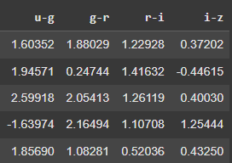
Feature Engineering
We created Color Index Features
Strong collinearity in raw magnitudes.
Feeding all of them add redundacy, which can confuse the model.
Color Indices are traditionally used in classification of Stars, galaxies, and quasars.
Standardization of all datasets seperately to avoid any data leakage

Slide 17
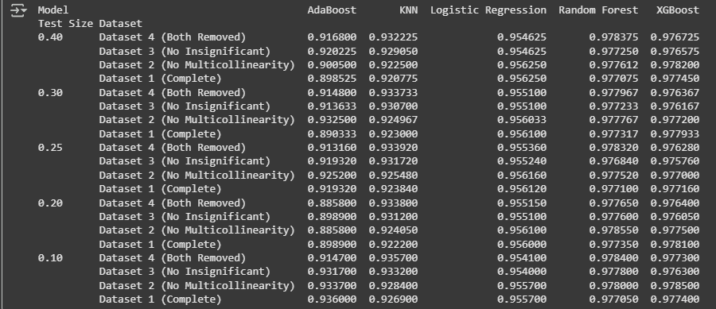
Results
Random Forest and XGBoost consistently dominated across all datasets and test sizes, achieving accuracies around 97.5–97.8%, showing strong robustness.
Logistic Regression was surprisingly competitive, with accuracy ~95.4–95.6% across all datasets, despite being a simpler linear model.
KNN showed stable performance (92–93%), slightly below Logistic Regression but better than AdaBoost in many cases.
AdaBoost had the most variability, with accuracies ranging from 88% (Dataset 1, 20% test split) to 93%, making it less reliable compared to other algorithms.

Slide 18
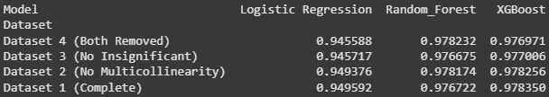
Model Selection with Tuning
We will be Selecting the model using k-fold validation
We will also be addressing the drawback of class imbalance by over sampling minority classes
Results:
Selected method/Algorithms/evaluation
Logistic Regression, Random forest classifier , XGBoost
K-fold Cross Validation(n-splits=10)
Average Accuracies of each model

Slide 19
Observation
1. Tree-based models like XGBoost handle irrelevant features well
Logistic Regression suffers if you keep noisy or multicollinear features → it inflates variance.
XGBoost, however, splits only on features that improve gain. If a column is useless, it just won’t use it.
So even with “extra” features, XGBoost can ignore them, but if those features carry tiny but useful signals, it will pick them up.
2. Overfitting risk
High accuracy (>0.97) on test splits is great, but with IDs included, the model may memorize survey-specific patterns rather than learning general astrophysical differences. That’s why:
For deployment on new telescope data, Dataset 3 or 4 (cleaned features) is safer. For SDSS-only classification, Dataset 1 might indeed be best

Slide 20
Final Fine-Tuned Model
Final Selection
Algorithm: XGBoost
Model Dataset : Dataset 4
Evaluation : Stratified K-fold cross validation
Hyper Parameter Tuning : Randomized Search
Class Imbalance: SMOTE (over_sampling) Only for model Training not applicable in web app UI
Best parameters
Subsample : 0.8
n_estimators : 200
Max depth : 10
Learning_rate : 0.2
Colsample_bytree : 1
Result :
Final Accuracy
0.9780997814890746

Slide 21
Conclusion
Across datasets, Random Forest and XGBoost consistently achieved the highest accuracies, with Logistic Regression slightly lower.
Dataset 2 and Dataset 4 performed slightly better than the complete dataset, confirming that removing collinear and insignificant features improved generalization.
Among all, Dataset 4 (both collinearity and insignificance removed) with XGBoost yielded the most stable and reliable results.
Using K-Fold Cross Validation (5 folds), Randomized Search for hyperparameter tuning, and SMOTE to address class imbalance, the model achieved an average accuracy of ~97.81%, making it the final chosen model.
This demonstrates that thoughtful feature selection + advanced ensemble methods + imbalance handling together provided the most robust classifier for distinguishing stars, galaxies, and quasars.
"After extensive experimentation, the best-performing model was XGBoost trained on Dataset 4 with balanced features. Using cross-validation and hyperparameter tuning, the model achieved ~97.81% accuracy, confirming it as our final deployment candidate."

Slide 22
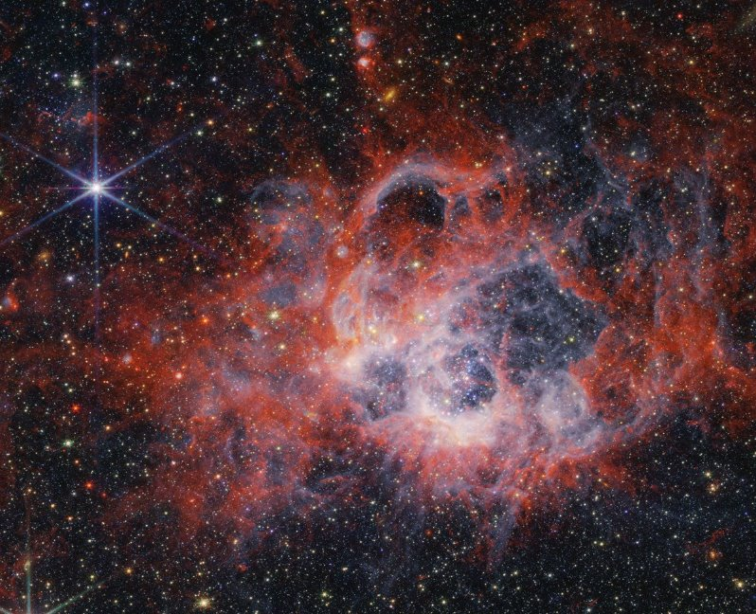
Deployment
Stellar Object Classifier

Slide 23
Questions ?

Slide 24
Thank You!

